Slide 1

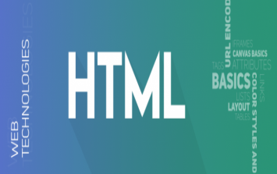
Front end
Web developmeNt
(Html)
Lecture-2

Slide 2
Today’s Agenda
Introduction To HTML
History of HTML
Components of HTML
Structure of HTML

Slide 3
INTRODUCTION
HTML is a language which instructs a web – browser that in what format the data should be displayed.
It contains commands that tells the browser how the embedded data is to be displayed on the web-page.

Slide 4
Conti.
HTML stands for Hypertext Markup Language, and it is the most widely used language to write Web Pages.
Hypertext refers to the way in which Web pages (HTML documents) are linked together.
Thus the link available on a webpage is called Hypertext.

Slide 5
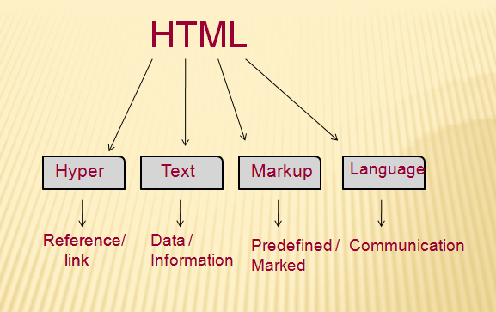
HTML

Slide 6
Conti.
As its name suggests, HTML is a Markup Language which means we use HTML to simply "mark up" a text document with tags that tell a Web browser how to structure it to display.
Originally, HTML was developed with the intent of defining the structure of documents like headings, paragraphs, lists, and so forth to facilitate the sharing of scientific information between researchers.

Slide 7
Conti.
Now, HTML is being widely used to format web pages with the help of different tags available in HTML language.

Slide 8
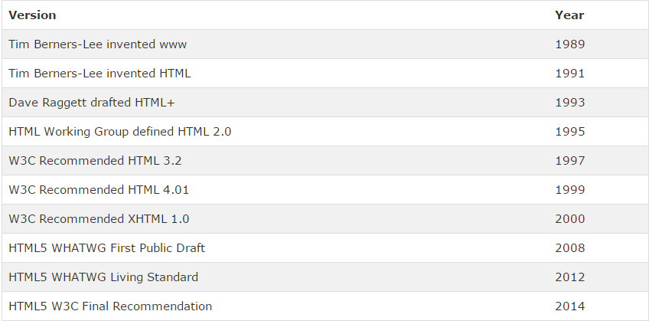
VERSIONS OF HTML

Slide 9
HISTORY
HTML was launched in 1995 .
HTML was created by Tim Berners-Lee in late 1991 but "HTML 2.0" was the first standard HTML specification which was published in 1995.
HTML 4.01 was a major version of HTML and it was published in late 1999.

Slide 10
Conti.
Though HTML 4.01 version is widely used but currently we are having HTML-5 version which is an extension to HTML 4.01, and this version was published in 2012.
It is a subset of more powerful language SGML(Standardised Generalised Markup Language) which itself is inherited from GML(Generalised Markup Language).

Slide 11
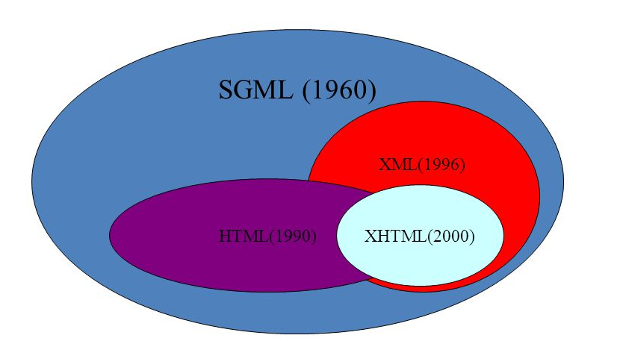

Slide 12
COMPONENTS OF HTML
Every HTML page consist of only 2 component :
Markup (Tags) : text embedded in angular bracket.
Content : text without angular bracket .

Slide 13
Conti
The difference between them is that browser can’t display markups instead markup contains information that tells the browser how to display the content.
Thus markup is a kind of ‘Metadata’ while content represents data.

Slide 14
SOFTWARE - REQUIRED
Only two software are required which are always available they are :
A text editor like notepad to write the html code.
A web – browser to test the code and the resulting web page
However, to be more productive and code faster we must always prefer an IDE , and in this course our preferred IDE will be VS Code.
.

Slide 15
STRUCTURE OF HTML
Every HTML code consist of two sections :
<html>
HEAD
BODY
</html>

Slide 16
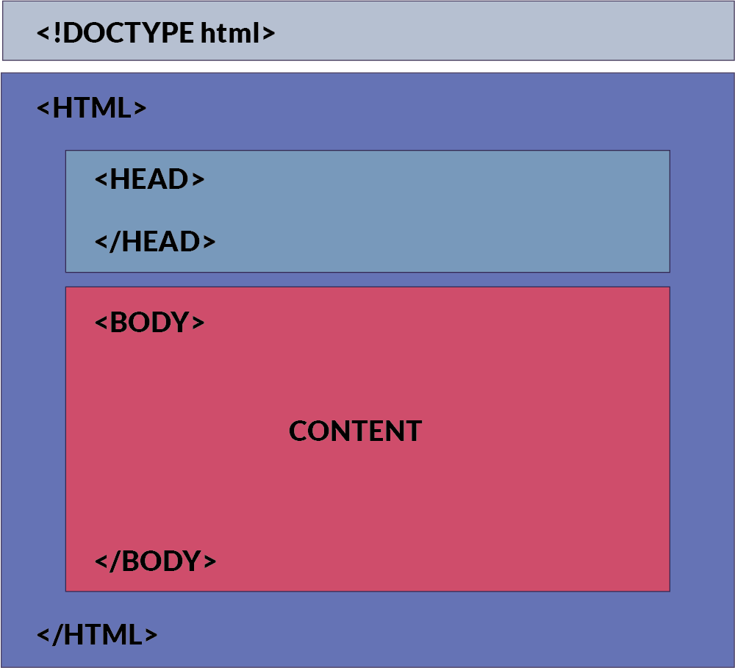
STRUCTURE OF HTML

Slide 17
Conti.
HEAD section contains information about HTML which is mostly used by browser and search engines.
This information is not mean for the users and isn’t directly displayed to the user.
BODY section mainly contains information which will be displayed to user.

Slide 18
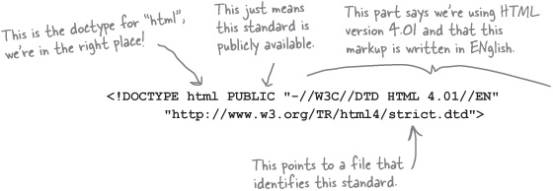
DOCTYPE -ELEMENT

Slide 19
DOCTYPE - ELEMENT
It is the starting element in HTML file.
It tells the browser that this HTML document is an HTML 4.01 document which confirms to standards set by W3C and written in English language.

Slide 20
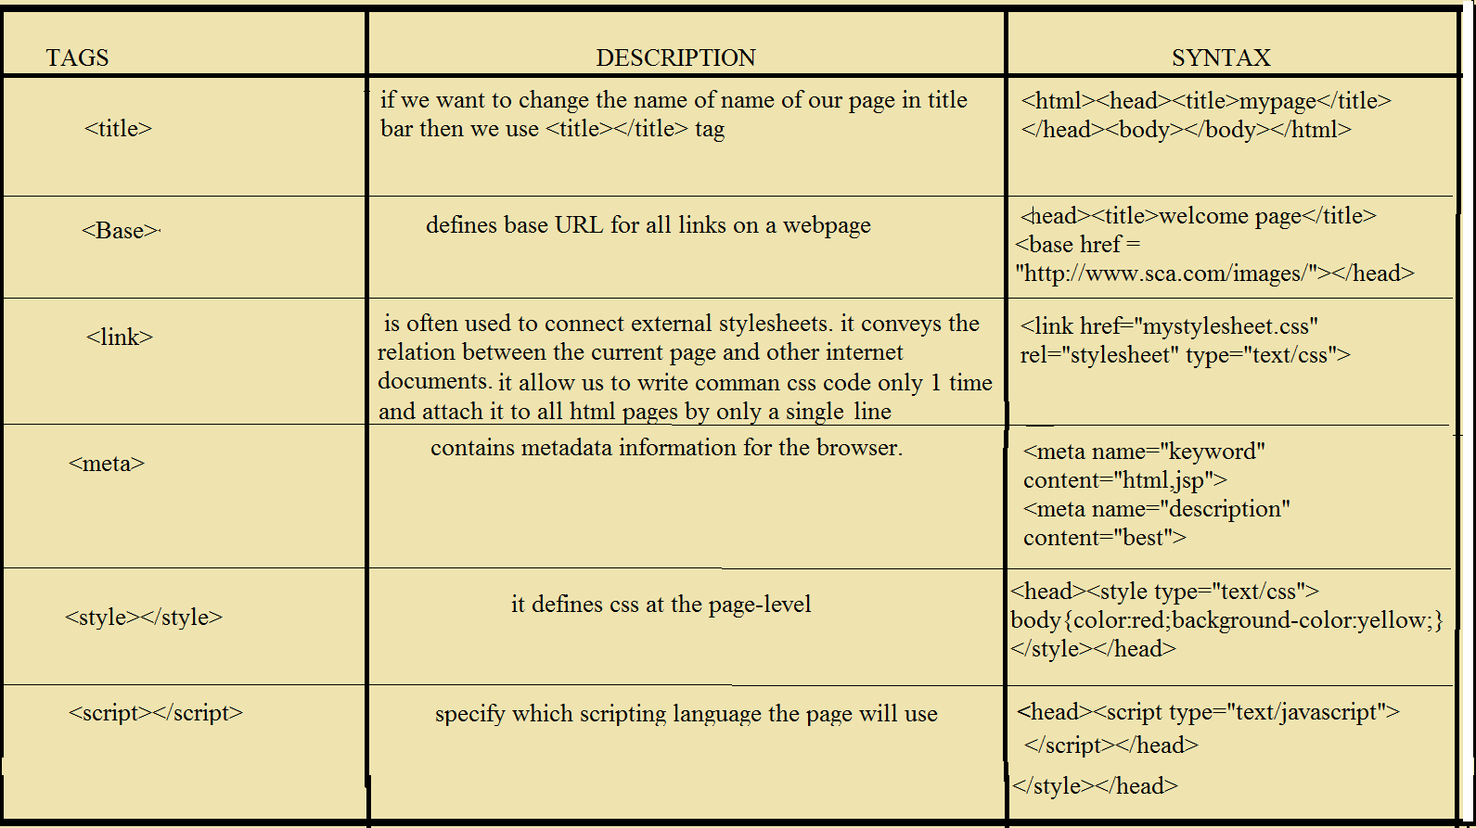
COMPONENT OF HEAD SECTION

Slide 21
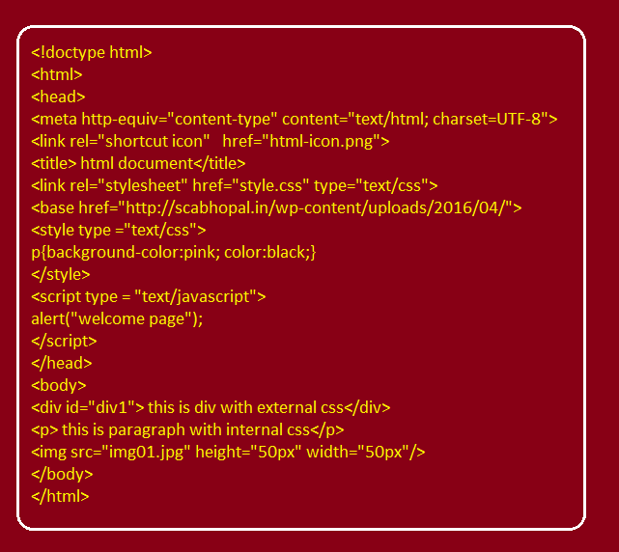
EXAMPLE PROGRAM

Slide 22
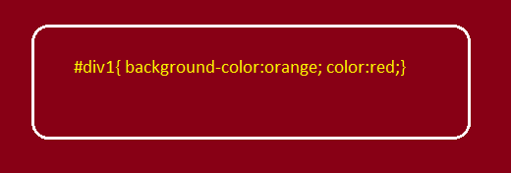
THE “styles.css” FILE

Slide 23
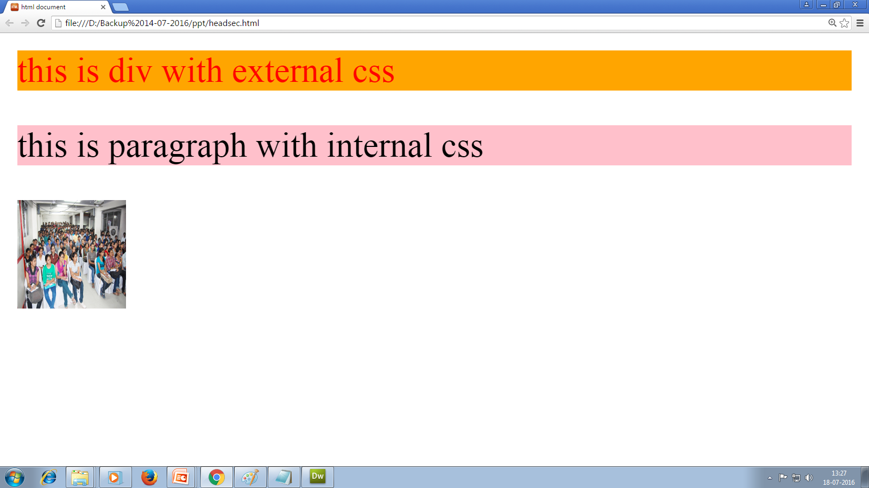
OUTPUT

Slide 24

END OF LECTURE
For any queries mail us @: scalive4u@gmail.com
Call us @ : 0755-4271659, 9826686245
Agenda for Next Lecture:
The <body> Tag
Different categories of tags
Inline v/s Block elements

